Slide 1
ONLINE COMPLAINT MANAGEMENT SYSTEM
TEAM WORK BY
M.D.KEERTHI REDDY 17113242
B.SURESH REDDY 17113199
N.SARADA 17113203

Slide 2
Abstract
The Online Complaint Management System for Civic to Manage and Track complaints raised by residents of Vellore district. To decrease the time taken towards resolving complaints that have a major impact using voting processes. To improve customer satisfaction with respect to complaint management Online Complaint Management System provides an online way of solving the problems faced by the public by saving time. The objectiveof the complaints management system is to make complaints easier to coordinate, monitor, track and resolve, and to provide company with an effective tool to identify and target problem areas, monitor complaints handling performance and make business improvements.
INTRODUCTION
The online complaint management system for civic is going to managing details about public complaints. As there are many issues with respect to taking action for public complaints in any city. This system is very useful for public to giving complaints to government officer. This is new system we are implementing for public. There is also a major need to collect, review and understand the nature of conflict management and complaint systems around the world. A number of Artificial Intelligence technologies are helpful in complaint resolution process, understanding the attitudes of involved parties and reasoning about them,based on Belief-desire-intention model. Concept learning is an adequate formalism to reason about complaints.
FUNCTIONAL REQUIREMENTS:
MODULES: The Complaints Registration System is supposed to have the
following features.

Slide 3
• Registration of people
• Registration of Complaints
• Status of all Complaints
• Tacking Complaints Action
• Vote for Complaints Responds for Complaints
■ Purpose
Providing an online way of solving the problems faced by the public by saving time and eradicate corruption.
■ Scope
• Providing accessibility to all users of the system who have a valid username and password. This system also provides the following facilities such as:
S Donating money to the organizations which help the poor.
S Posting the problem they are facing S Communication through discussion forums, feedback, mail S Monthly newsletter and magazine.
HIGH LEVEL DESIGN:
High level design explains the architecture that would be used for developing a software product. The architecture diagram provides an overview of an entire system, identifying the main components that would be developed for the product and their interfaces. The HLD uses possibly nontechnical to mildly technical terms that should be understandable to the administrators of the

Slide 4
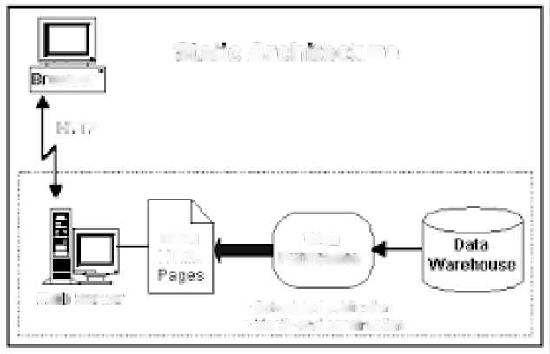
system. In contrast, low-level design further exposes the logical detailed design of each of these elements for programmers.
Static Architecture
flirser
,.T-n
stalic
HTML
We ci
PilLjliL.iliuiJ
we: Berra
■ ^mauled PLU«IIO-I
■ MtTih-ci -a cant UCIBTI
Now, our first module is the user or customer. These are brief diagrams of user , admin and manager of what they will do.
Er diagram of user:

Slide 5
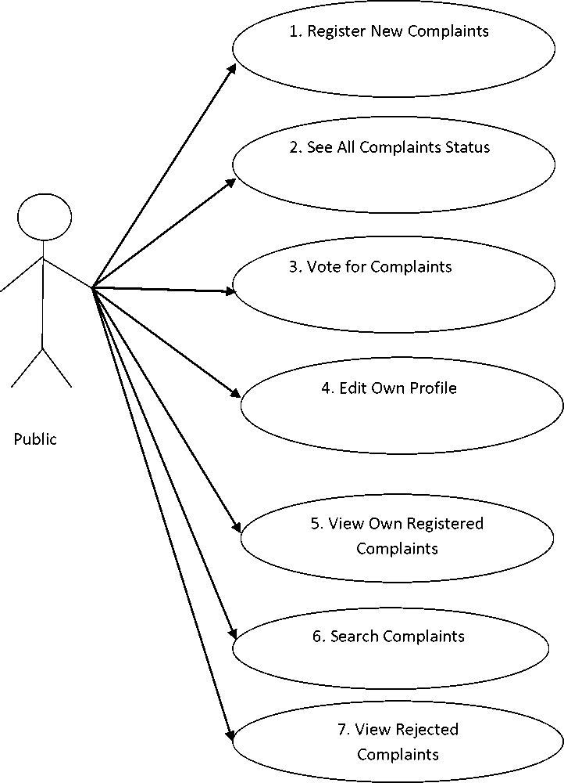

Slide 6
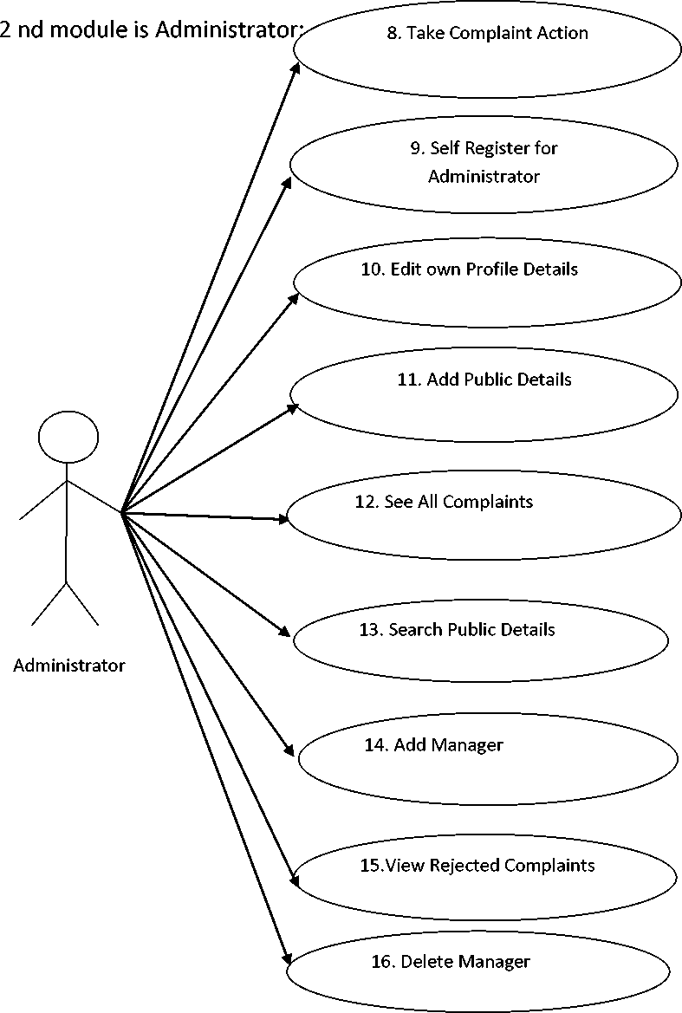

Slide 7
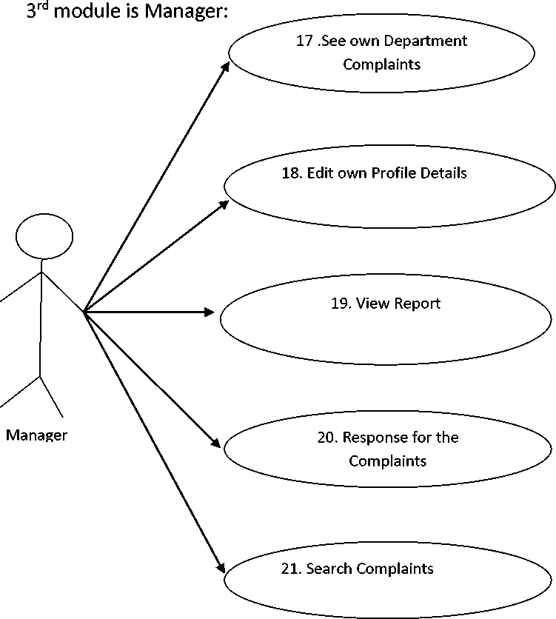

Slide 8
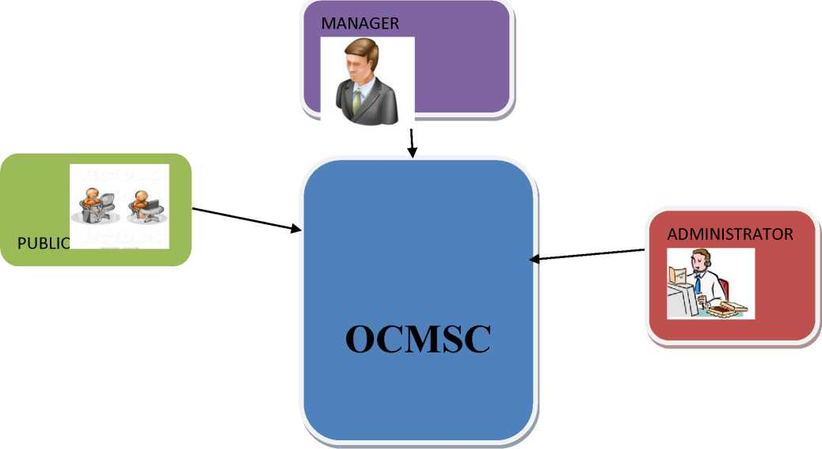
1. Overall Description
2. Product Perspective (view point/point of view)

Slide 9
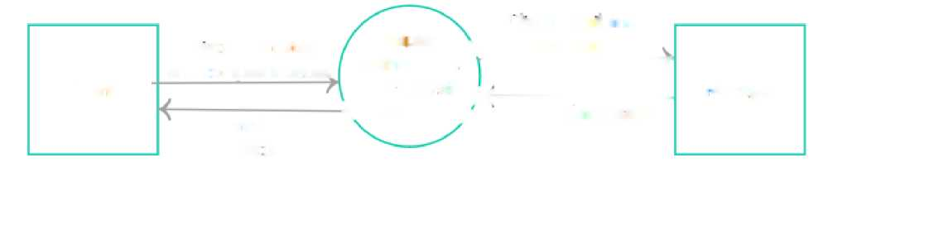
Data flow diagram:
 | Registration details | Complaint | Client detail and \ complaint
 | and complaint detail | maintenance | ----7
Client |  | and analysis | M--— | Manager
 | Complaint | \ system / | Complaint status
 | status
LOW LEVEL DESIGN:
The goal of LLD or a low-level design document (LLDD) is to give the internal logical design of the actual program code. Low-level design is created based on the high-level design. LLD describes the class diagrams with the methods and relations between classes and program specs. It describes the modules so that the programmer can directly code the program from the document.

Slide 10

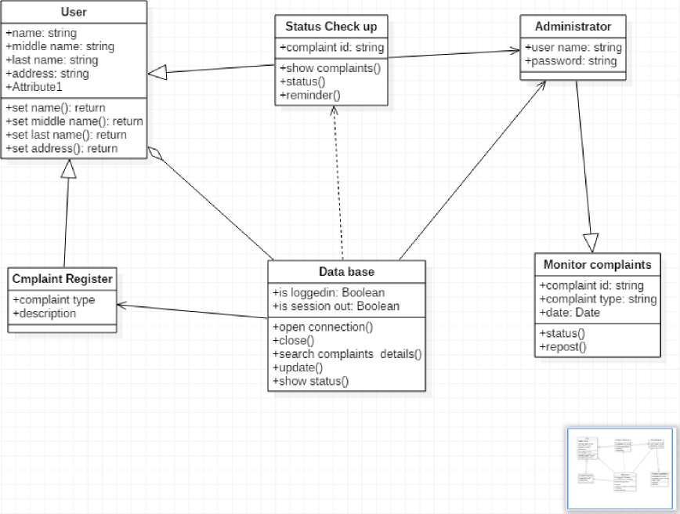
CLASS DIAGRAM:

Slide 11
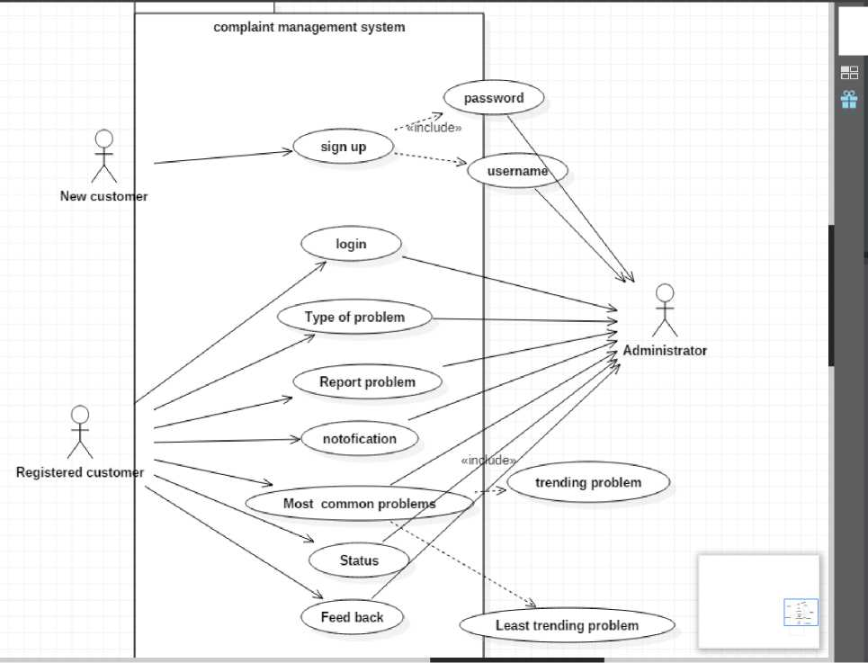

DOCUMENTATION OF COMPLAINT MANAGEMENT
SOFTWARE REQUIREMENT SPECIFICATION (SRS)
Product Functions
The Administrator will be able to register Public details in the system
1. First Name
2. Last Name
3. Aadhaar ID
4. Username
5. Password

Slide 12
6. Confirmation Password
7. Address
8. Phone Number
9. Date of Birth
10. Gender
11. City
12. Email ID
13. The public will be able to register complaints using following details
1. Complaint department
2. Complaints details
14. The public can view all the complaints using following details
1. Username
2. Password
15. Public will be able to view own registered complaints.
16. Public will be able to vote for complaints.
17. Administrator will be able to registered in the system using following details
1. First name
2. Last name
3. Aadhaar ID
4. Password
5. Confirmation Password
6. Date of Birth
7. Gender
8. Address
9. Mobile Number
10. Qualification
11. Email ID

Slide 13
12. City
18. Administrator will be able to reject registered complaints.
19. Administrator will be able to post registered complaints.
20. Administrator will be able to see all the complaints.
21. Administrator will be able to search public details using username.
22. Administrator will be able to add manager details.
1. First Name
2. Last Name
3. Aadhaar ID
4. Password
5. Confirmation Password
6. Qualification
7. Department
8. Date of Birth
9. Gender
10. Address
11. City
12. Email ID
13. Mobile Number
14. About You
23. Administrator will be able to view rejected complaints.
24. Manager will be able to view they own department complaints.
25. Manager will be able to search complaints using date.
26. Manager will be able to response for the complaints.

Slide 14
27. All people can edit own profile details.
28. Manager will be able to view report.
User characteristics
The proper user interface and online help must be sufficient to educate the users on how to use the system without any problems. Peoples without any basic knowledge of computer systems will be able to adapt (get a feel) to the form based user interfaces offered by the system with sufficient documentation.
Constraints
a. Migration movement of all existing complaints data on paper to the database .
b. Validation of aadhaar id, user name entered into the system.
related works : The idea of a systems approach has endured well. In recent years however, there has been discussion as to whether conflict should be "managed" by the organization—or whether the goal is to understand, deal with and learn from conflict.
User Interface Requirements
■ Professional look and feel
■ Use of AJAX at least with all registration forms
■ Browser testing and support for IE, NN, Mozilla, and Fire fox.
■ Reports exportable in .XLS, or any other desirable format.
1_
Register new complaints

Slide 15
Public can register the complaints using following details
• • | Complaint department Complaint details
The public who register complaints the people must be registered with the system
The user can see the successful registered message
Failed message is displayed to the user
Manager, Administrator, Public
This use case is initiated based on the request from the public user
Step | Action
1 | The End user selects the register complaint link
2 | The End user selects the type of complaint department from the drop down box
3 | The end user enters the complaint details in text area
4 | The End User Clicks on the register button
Step | Branching Action
1 | Complaint details is added into database
EXISTING SYSTEM : In the existing system the people must go to the office for any kind of help. The users can post their problems but cannot get the details of the problems and some other services. This system doesn't have much popularity
2
See all complaints details and is not user friendly.

Slide 16
The System will show all complaints details in public login
• Complaint department
• Complaint Id
• Complaint date
• Complaints registered id
• Complaints details
• Vote for complaints
• Response for complaints
• Complaint Status
The people who see the complaints details they should login in to the system
All complaints details shown to the end user
Please try again some times
Manager, Administrator, Public
This use case is initiated based on the request from the public login
Step | Action
1 | The End user selects the see all complaints details link
Step | Branching Action
1 | The all complaints details retrieves from the database
3_
Vote for Complaints

Slide 17
Public who votes for complaints they should login to system using following details.
• Username
• Password
The System will update the complaints votes into database.
The user first login to the system
Successful voted message shown to the user.
You voted already.
Or
Try After Some times
Manager, Administrator, Public
This use case is initiated based on the request from the public vote link.
Step
Action
1
The end user clicks the vote link.
2
The vote details shown to user.
Step
Branching Action
1
A database triggers all vote details will be update into database.
4_
Edit own Profile - public_
The System will update the database to hold the following edited details.
• Password
• Conformation Password
• Address
• DOB
• Mobile Number
• Gender

Slide 18
• • | City Email ID
The public people first login to the system
Successfully your profile updated message shown to the user
Please fill the required filled message shown to the user
Manager, Administrator, Public
This use case is initiated based on the request from the public
Step | Action
1 | The End user selects the Edit profile link
Step | Branching Action
1 | System updates the data into the database
5
View own Registered Complaints-public_
The System will update the database to hold the following edited details Name
• Complaint department
• Complaint Id
• Complaint details
• Date of complaints
• Complaint Action
The Public first login to the system_
Complaint successfully received complaint details.
Please try again some times._
Manager, Administrator, Public_
This use case is initiated based on the request from the public
Step | Action
1 | The End user selects the view complaints details link
Step | Branching Action
1 | System retrieves all data form database.

Slide 19
6
Search Complaints -Public_
The public will be able to search complaints Complaint_ID
The public must login to the system
• User name
• Password
Public view details of complaints by given Complaint_ID
No Complaints registered given date
Manager, Administrator, Public
This use case is initiated based on the request from the Public
Step | Action
1 | The End user selects the Search complaints link
2 | To enter Complaint_ID in the Text box and display
3 | The end user presses the search button
Step | Branching Action
1 | The system retrieves all data from database
7_
View Rejected Complaints - Public_
The System will show following details to user
• Complaint department
• Complaint Id
• Complaint date
• Complaints registered id
• Complaints details_

Slide 20
• | Reason for Reject
The public first login to the system
All details show to the user
Please try after some times
Manager, Administrator, Public
This use case is initiated based on the request from the public.
Step | Action
1 | The End user selects the view rejected complaints link
Step | Branching Action
1 | System retrieves the data from the database.
8_
Take Complaint Action_
The system administrator post or reject all received complaints
• Complaint department
• Complaint Id
• Complaint details
• Complaint date
• Complaint registered id
• Complaint Option(Reject, Post)
The officer who posting complaint they should login to the system.
Complaints successfully posted message shown to the user.
Please try after some time
Administrator, Public, Manager
This use case is initiated based on the request from the Administrator
Step | Action
1 | The End user selects the view registered complaints link

Slide 21
Step | Branching Action
1a | The complaint action details get updated into the database.
This use case is initiated based on the request from the end user
Step | Action
1 | The End user selects the Edit profile link
Step | Branching Action
1a | The database is updating all edited details
12_
See all complaints details-Administrator_
The System will show all complaints details in Administrator login
• Complaint department
• Complaint Id
• Complaint date
• Complaints registered id
• Complaints details
• Vote for complaints
• Response for complaints
• Complaint Status
The administrator who see the complaints details they should login in to the system All complaints details shown to the end user Please try again some times
Manager, Administrator, Public
This use case is initiated based on the request from the public login

Slide 22
Step | Action
1 | The End user selects the see all complaints details link
Step | Branching Action
1 | The all complaints details retrieves from the database
14_
Add Manager_
The system will get following details from the user
• Fist Name
• Last Name
• Aadhaar ID
• Password
• Conformation Password
• Qualification
• Department
• DOB
• Gender
• Address
• City
• Email ID
• Mobile Number
• About User
The administrator first login to the system. Successfully registered message shown to the user. Please fill the following required fields if any blank
Manager, Administrator, Public
This use case is initiated based on the request from the Admin Officer
Step__Action_
1 The End user selects the add manager link

Slide 23
2 3 4 | The end user fill the text filed with text boxes The end user select date of birth form calendar box The end user select they department and city form dropdown box
Step | Branching Action
1 | The database is updating all new user details
15
View Rejected Complaints - Administrator
The System will show following details to user
• Complaint department
• Complaint Id
• Complaint date
• Complaints registered id
• Complaints details
• Reason for Reject
The officer first login to the system
All details show to the user
Please try after some times
Manager, Administrator, Public
This use case is initiated based on the request from the administrator.
Step
Action
1
The End user selects the view rejected complaints link
Step
Branching Action
1
System retrieves the data from the database.

Slide 24
17
See own Department Complaints - Manager_
The System will shown following complaint details.
• Complaint department
• Complaint Id
• Complaint date
• Complaints registered id
• Complaints details
• Vote for complaint
• Response for complaint
• Complaint Status
The manager first login to the system
The manager can see complaints details
Please try after some times
Manager, Administrator, Public
This use case is initiated based on the request from the manager.
Step | Action
1 | The End user selects the view complaints link
Step | Branching Action
1 | System will retrieves all details form database.
20
Response for complaints - manager
Manager will be able to response for the complaints
The user must be login to the system

Slide 25
Successfully posted your command message shown to the user
Fill the your text
Manager, Administrator, Public
This use case is initiated based on the request from the Manager
Step | Action
1 | The End user selects the response for complaints link
Step | Branching Action
1 | The database is updates response reports
21
Search Complaints - Manager
The Manager will be able to search complaints using DATE
The officer must login to the system
• Aadhaar ID
• Password
• Department
Officer view details of complaints by given date
No Complaints registered given date
Manager, Administrator, Public
This use case is initiated based on the request from the Manager
Step | Action
1 | The End user selects the Search complaints link
2 | Selects the Date from the calendar display
3 | The end user presses the search button
Step | Branching Action
1 | The system retrieves all data from database

Slide 26
User Requirements Template
Requirement ID | Description
F1 | Registration of people
F.2 | Registration of complaints
F.3 | Status of complaints
F.3.1 | Tracking complaints
F.3.2 | Vote for complaints
F.4 | Responds for complaints
Description of functionalities
Requirement Id and Name | F.2 Registration of complaints
Description
Input | Giving complaints
Output | People comfort
Action | Solving complaints
Precondition | Every Dlps operator should login and check the problems
Postcondition | The problem page will be displayed
Requirement Id and Name | F1.1 Registration of people
Description
Input | Giving their information
Output | Creating an account
Action | Discussing and solving the people problems
Precondition | Each user must have a valid id and password
Postcondition | Home page will be displayed

Slide 27
Requirement Id and Name | F.3 Status of all complaints
Description
Input | No. of complaints
Output | Complaints to be solved
Action | -
Precondition | The Dips should login and take the request from the citizen
Postcondition | The operator should update the possible information
Requirement Id and Name | F.3.1 Tracking complaints action
Description
Input Money
Output | Solving problems
Action | Tracking the problems
Precondition | The admin should login and create the employee
Postcondition | The created/added should be alert to be displayed
Requirement Id and Name | F.3.2 Vote for complaints
Description
Input | Major complaints
Output | People comfort
Action | Solving problems
Precondition | Money
Postcondition | Same as F.3

Slide 28
DOCUMENTATION:
CODE;
<!DOCTYPE html>
<html>
<head>
<title>
new user for OCMSHS
</title>
<link rel="stylesheet" href="css/public_user.css">
</head>
<body>
<form name="frm" action="#" method="post">
<h1>Registeration for new User:</h1>
<br>NOTE:<b>*</b>- manitory <hr id="hr">
<center><table id="signup_table">
<tr>
<td>First Name:<b>*</b></td>
<td><input type="text" required name="fname"></td>
</tr>
<tr>
<td>Last Name:</td>
<td><input type="text" required name="lname"></td>

Slide 29
</tr>
<tr>
<td>Username:<b>*</b></td>
<td><input type="text" required name="uname"></td>
</tr>
<tr>
<td>Email Id:<b>*</b></td>
<td><input type="email" required name="email"></td>
</tr>
<tr>
<td>Date Of Birth:<b>*</b></td>
<td><input type="date" required name="dob"></td>
</tr>
<tr>
<td>Address:<b>*</b></td>
<td><textarea type="address"></textarea></td>
</tr>
<tr>
<td>Gender</td>
<td><select><option>--select--
</option><option>Male</option><option>Female</option></select></td>
</tr>
<tr>
<td>Mobile Number:<b>*</b></td>

Slide 30
<td><input type="text" required name="phoneno
size="10"></td>
</tr>
<tr>
<td>Create Password :<b>*</b></td>
<td><input type="text" required name="pass1"></td>
</tr>
<tr>
<td>conform Password :<b>*</b></td>
<td><input type="text" required name="pass2"></td>
</tr>
<tr>
<td>Security question:<b>*</b></td> <td><select><option>--select--</option>
<option>what is your favourite
number?</option>
<option>what is your favourite
color?</option></select></td>
</tr>
<tr>
<td>Answer:<b>*</b></td>
<td><input type="text" required name="ans"></td>
</tr>
<tr>
<td>select your district:<b>*</b></td>

Slide 31
<td><select><option>--select--</option>
<option>vellore</option>
<option>chennai</option></select></td>
</tr>
<tr>
<td><input type="submit" name="submit" id="smt"
value="submit"></td>
<td><input type="reset" name="reset" id="smt"
value="reset"></td>
</tr>
</table></center>
</form>
</body>
</html>

Slide 32
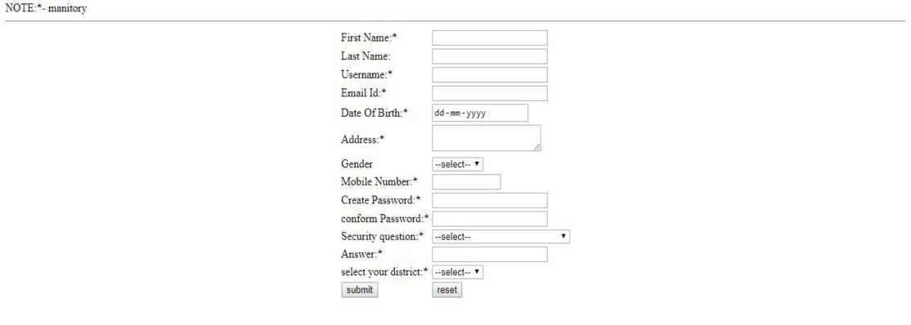
Registeration for new User:
<!DOCTYPE html>
<html>
<head>
<link rel="stylesheet" href="css/admin.css">
</head>
<body>
<fieldset id="signin_fieldset">
<form name="signin_frm" method="post" action="#">
<table id="signin_table"> <tr>
<td>username:</td>

Slide 33
<td><input type="text" name="name"
required></td>
</tr>
<tr>
<td>password</td>
<td><input type="password" name="pass"
required></td>
</tr>
<tr>
<td><input type="submit" value="login"
id="smt" name="submit"></td>
<td><input type="reset" value="clear"
id="smt"></td>
</tr>
<tr>
<td><a href="forget_pass.php">forget
password?</a></td>
</tr>
</table>
</form>
</fieldset>
</body>
</html>

Slide 34
Account details
<html>
<link rel="stylesheet" href="css/account_info.css">
<body>
<center><table id="account_table">
<tr>
<td>First Name:</td>
<td><input type="submit" value="Change" name="fname"
id="change"></td>
</tr>
<tr>
<td>Last Name:</td>
<td><input type="submit" value="Change" name="lname"
id="change"></td>
</tr>
<tr>
<td>Email Id:</td>
<td><input type="submit" value="Change" name="email"
id="change"></td>
</tr>
<tr>
<td>Username:</td>
<td><input type="submit" value="Change"
name="uname" id="change"></td>
</tr>
<tr>

Slide 35
<td>Password:</td>
<td><input type="submit" value="Change" name="pass"
id="change"></td>
</tr>
<tr>
<td>Address:</td>
<td><input type="submit" value="Change"
"change"></td>
</tr>
<tr>
<td>Mobile Number:</td>
<td><input type="submit" value="Change"
'change"></td>
</tr>
</table></center>
name="address" id
name="mobile" id=
</body>
</html>

Slide 36
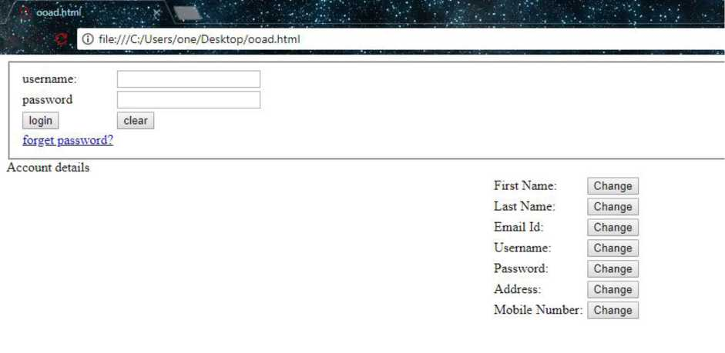
<!DOCTYPE html> <html>
<head>
<link rel="stylesheet" href="css/public_user.css">
</head>
<body>
<form action="#" method="post">
<table width="600" border="0" align="center" cellpadding="5" cellspacing="1" bgcolor="#336699" id="make_table" >
<tr >
<td>:: Make Complains ::</td>
</tr>
<tr>
<td ><div align="center"></div>

Slide 37
<table width="100%" border="0" cellpadding="2" cellspacing="1" > <tr align="center">
<td colspan="2">&nbsp;</td>
</tr>
<tr >
<td >&nbsp;Complain Type </td>
<td >
<select name="compType" >
<option >--Select--</option>
<option value="hardware">Hardware Failure /
Replacement</option>
<option value="software">Software Installation /
Upgradation</option>
<option value="network">Netword / LAN / Internet
Problem</option>
</select></tr>
<tr >
<td >&nbsp;Complain Title </td>
<td ><input name="compTitle" type="text" value="" size="50" maxlength="100" /></td> </tr>
<tr >
<td valign="top">&nbsp;Complain Description .</td> <td ><textarea cols="50" rows="6" ></textarea></td>
</tr>

Slide 38
<tr>
<td width="200">&nbsp;</td>
<td width="372">&nbsp;</td>
</tr>
<tr>
<td>Your Detail:</td>
</tr>
<tr>
<td>Name:</td>
<td><input type="text" size="50" maxlength="100" /></td>
</tr>
<tr>
<td>Email Id:</td>
<td><input type="email" size="50" maxlength="100" /></td>
</tr>
<tr>
<td>Address:</td>
<td><textarea></textarea></td>
</tr>

Slide 39
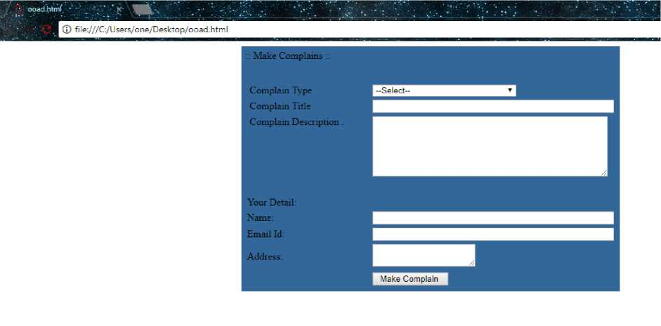
<tr>
<td>&nbsp;</td>
<td><input name="" type="submit" value=" Make Complain " id="smt"></td> </tr>
</table></td>
</tr>
</table>
</form>
<p>&nbsp;</p>
<p>&nbsp;</p>
<p>&nbsp;</p>
</body>
</html>

Slide 40
<html>
<head>
<link rel="stylesheet" href="css/public_user.css"> </head>
<body>
<center>
<form action="#" method="post">
<table width="600" border="0" align="center" cellpadding="5" cellspacing="1" bgcolor="#336699" id="make_table" >
<tr >
<td>:: Status Of Your Complains ::</td>
</tr>
<tr>
<td ><div align="center"></div>
<table width="100%" border="0" cellpadding="2" cellspacing="1" >
<tr align="center">
<td colspan="2">&nbsp;</td>
</tr>
<tr >
<td >&nbsp;Complain Type </td>
<td >
<select name="compType" >
<option >--Select--</option>

Slide 41
<option value="hardware">Hardware Failure /
Replacement</option>
<option value="software">Software Installation /
Upgradation</option>
<option value="network">Netword / LAN / Internet
Problem</option>
</select></tr>
</table></td>
</tr>
</table>
<br><br>
<table width="600" border="0" align="center" cellpadding="5" cellspacing="1" bgcolor="#336699" id="make_table" >
<tr>
<th colspan="4"><h3>Registered complaints<h3></th>
</tr>
<tr>
<th>S no:</th>
<th>Complaint title:</th>
<th>Engineer Details:</th>
<th>Status:</th>
</tr>
</table>
</form>

Slide 42
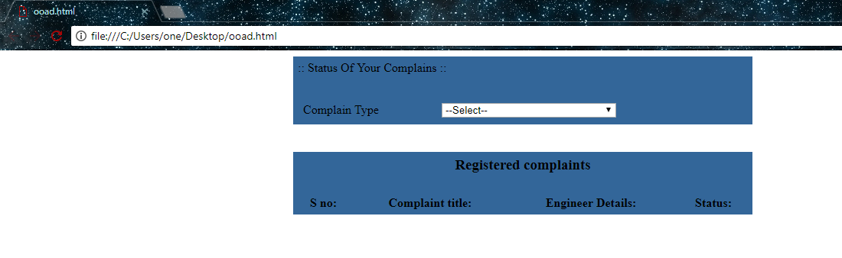
</center>
</body>
</html>

